Slide 1
Mobile Programming with Android Lecture 04 – User Interface
Charisma Tubagus S

Slide 2
Program UICoding1
Start New Android Studio Project
In configure your project window, fill out the following
Application Name: UICoding1
Company Domain: write whatever you want
Project Location: Leave as default
In target Android Devices, pick the Minimum SDK as Gingerbread
In the activity window, pick the Empty Activity
In the customize Activity window, fill Activity Name as MainActivity and leave as default one

Slide 3
activity_main.xml
<?xml version="1.0" encoding="utf-8"?>
<LinearLayout xmlns:android="http://schemas.android.com/apk/res/android"
android:layout_width="fill_parent"
android:layout_height="fill_parent"
android:orientation="vertical" >
<TextView android:id="@+id/text"
android:layout_width="wrap_content"
android:layout_height="wrap_content"
android:text="Hello, saya TextView" />
<Button android:id="@+id/button"
android:layout_width="wrap_content"
android:layout_height="wrap_content"
android:text="Hello, saya Button" />
</LinearLayout>

Slide 4
MainActivity.java
package com.wilis.uicoding1;
import android.app.Activity;
import android.os.Bundle;
public class MainActivity extends Activity {
/** Called when the activity is first created. */
@Override
public void onCreate(Bundle savedInstanceState) {
super.onCreate(savedInstanceState);
setContentView(R.layout.main);
}
}

Slide 5
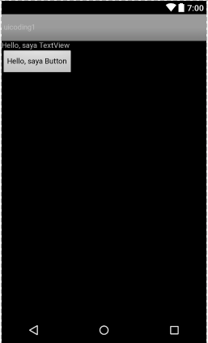

Slide 6
Program UICoding2
Start New Android Studio Project
In configure your project window, fill out the following
Application Name: UICoding2
Company Domain: write whatever you want
Project Location: Leave as default
In target Android Devices, pick the Minimum SDK as Gingerbread
In the activity window, pick the Empty Activity
In the customize Activity window, fill Activity Name as MainActivity and leave as default one

Slide 7
activity_main.xml
<?xml version="1.0" encoding="utf-8"?>
<LinearLayout xmlns:android= "http://schemas.android.com/apk/res/android"
android:orientation="vertical"
android:layout_width="fill_parent"
android:layout_height="fill_parent"
>
<TextView
android:layout_width="wrap_content"
android:layout_height="wrap_content"
android:text="Element One"
/>
<TextView
android:layout_width="wrap_content"
android:layout_height="wrap_content"
android:text="Element Two"
/>

Slide 8
activity_main.xml
<TextView
android:layout_width="wrap_content"
android:layout_height="wrap_content"
android:text="Element Three"
/>
</LinearLayout>

Slide 9
MainActivity.java
package com.wilis.uicoding2;
import android.app.Activity;
import android.os.Bundle;
public class MainActivity extends Activity {
/** Called when the activity is first created. */
@Override
public void onCreate(Bundle savedInstanceState) {
super.onCreate(savedInstanceState);
setContentView(R.layout.main);
}
}

Slide 10
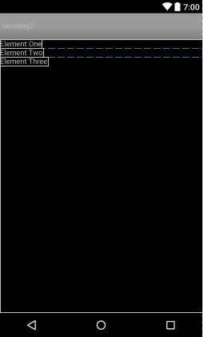

Slide 11
Program UICoding3
Start New Android Studio Project
In configure your project window, fill out the following
Application Name: UICoding3
Company Domain: write whatever you want
Project Location: Leave as default
In target Android Devices, pick the Minimum SDK as Gingerbread
In the activity window, pick the Empty Activity
In the customize Activity window, fill Activity Name as MainActivity and leave as default one

Slide 12
activity_main.xml
<?xml version="1.0" encoding="utf-8"?>
<RelativeLayout xmlns:android= "http://schemas.android.com/apk/res/android"
android:layout_width="fill_parent"
android:layout_height="fill_parent"
>
<TextView
android:id="@+id/EL01"
android:layout_width="wrap_content"
android:layout_height="wrap_content"
android:text="Element One"
/>
<TextView
android:id="@+id/EL02"
android:layout_width="wrap_content"
android:layout_height="wrap_content"
android:text="Element Two"
android:layout_below="@id/EL01"
/>

Slide 13
activity_main.xml
<TextView
android:layout_width="wrap_content"
android:layout_height="wrap_content"
android:text="Element Three"
android:layout_toRightOf="@id/EL01"
/>
</RelativeLayout>

Slide 14
MainActivity.java
package com.wilis.uicoding3;
import android.app.Activity;
import android.os.Bundle;
public class MainActivity extends Activity {
/** Called when the activity is first created. */
@Override
public void onCreate(Bundle savedInstanceState) {
super.onCreate(savedInstanceState);
setContentView(R.layout.main);
}
}

Slide 15
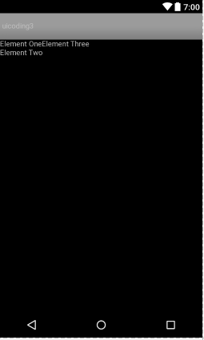

Slide 16
Program UICoding4
Start New Android Studio Project
In configure your project window, fill out the following
Application Name: UICoding4
Company Domain: write whatever you want
Project Location: Leave as default
In target Android Devices, pick the Minimum SDK as Gingerbread
In the activity window, pick the Empty Activity
In the customize Activity window, fill Activity Name as MainActivity and leave as default one

Slide 17
activity_main.xml
<?xml version="1.0" encoding="utf-8"?>
<AbsoluteLayout xmlns:android=
"http://schemas.android.com/apk/res/android"
android:layout_width="fill_parent"
android:layout_height="fill_parent"
>
<TextView
android:layout_width="wrap_content"
android:layout_height="wrap_content"
android:text="Element One"
/>
<TextView
android:layout_width="wrap_content"
android:layout_height="wrap_content"
android:text="Element Two"
android:layout_x="30px"
android:layout_y="30px"
/>

Slide 18
activity_main.xml
<TextView
android:layout_width="wrap_content"
android:layout_height="wrap_content"
android:text="Element Three"
android:layout_x="50px"
android:layout_y="50px"
/>
</AbsoluteLayout>

Slide 19
MainActivity.java
package com.wilis.uicoding4;
import android.app.Activity;
import android.os.Bundle;
public class MainActivity extends Activity {
/** Called when the activity is first created. */
@Override
public void onCreate(Bundle savedInstanceState) {
super.onCreate(savedInstanceState);
setContentView(R.layout.main);
}
}

Slide 20
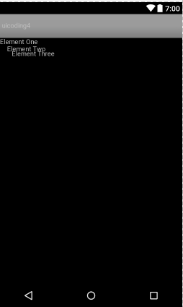

Slide 21
Program UICoding5
Start New Android Studio Project
In configure your project window, fill out the following
Application Name: UICoding5
Company Domain: write whatever you want
Project Location: Leave as default
In target Android Devices, pick the Minimum SDK as Gingerbread
In the activity window, pick the Empty Activity
In the customize Activity window, fill Activity Name as MainActivity and leave as default one

Slide 22
activity_main.xml
<?xml version="1.0" encoding="utf-8"?>
<TableLayout xmlns:android="http://schemas.android.com/apk/res/android"
android:layout_width="fill_parent"
android:layout_height="fill_parent">
<TableRow>
<TextView
android:layout_width="wrap_content"
android:layout_height="wrap_content"
android:text="Element One A"
/>
<TextView
android:layout_width="wrap_content"
android:layout_height="wrap_content"
android:text="Element One B"
/>
</TableRow>

Slide 23
activity_main.xml
<TableRow>
<TextView
android:layout_width="wrap_content"
android:layout_height="wrap_content"
android:text="Element Two A"
/>
<TextView
android:layout_width="wrap_content"
android:layout_height="wrap_content"
android:text="Element Two B"
/>
</TableRow>
</TableLayout>

Slide 24
MainActivity.java
package com.wilis.uicoding5;
import android.app.Activity;
import android.os.Bundle;
public class MainActivity extends Activity {
/** Called when the activity is first created. */
@Override
public void onCreate(Bundle savedInstanceState) {
super.onCreate(savedInstanceState);
setContentView(R.layout.main);
}
}

Slide 25


Slide 26
Program UICoding6
Start New Android Studio Project
In configure your project window, fill out the following
Application Name: UICoding6
Company Domain: write whatever you want
Project Location: Leave as default
In target Android Devices, pick the Minimum SDK as Gingerbread
In the activity window, pick the Empty Activity
In the customize Activity window, fill Activity Name as MainActivity and leave as default one

Slide 27
activity_main.xml
<?xml version="1.0" encoding="utf-8"?>
<ScrollView xmlns:android= "http://schemas.android.com/apk/res/android"
android:layout_width="fill_parent"
android:layout_height="wrap_content"
android:scrollbars="vertical">
<LinearLayout
android:orientation="vertical"
android:layout_width="fill_parent"
android:layout_height="fill_parent"
>
<TextView
android:text="Login Screen"
android:layout_width="fill_parent"
android:layout_height="wrap_content"
/>

Slide 28
activity_main.xml
<TextView
android:text="Username:"
android:layout_width="wrap_content"
android:layout_height="wrap_content"
/>
<EditText
android:id="@+id/username"
android:layout_width="fill_parent"
android:layout_height="wrap_content"
/>
<TextView
android:text="Password:"
android:layout_width="wrap_content"
android:layout_height="wrap_content"
/>

Slide 29
activity_main.xml
<EditText
android:id="@+id/password"
android:layout_width="fill_parent"
android:layout_height="wrap_content"
android:inputType ="textPassword"
/>
<Button
android:id="@+id/loginbutton"
android:layout_width="wrap_content"
android:layout_height="wrap_content"
android:text="Login"
/>

Slide 30
activity_main.xml
<TextView
android:id="@+id/status"
android:layout_width="fill_parent"
android:layout_height="wrap_content"
android:textStyle="normal"
android:text="Enter Username and Password"
/>
</LinearLayout>
</ScrollView>

Slide 31
MainActivity.java
package com.wilis.uicoding6;
import android.app.Activity;
import android.os.Bundle;
public class MainActivity extends Activity {
/** Called when the activity is first created. */
@Override
public void onCreate(Bundle savedInstanceState) {
super.onCreate(savedInstanceState);
setContentView(R.layout.main);
}
}

Slide 32
